Slide 1


Advanced Topics
Travis Hance (and the Verus Team)
CMU
MPI-SWS (to join soon)
https://verus.rs/

Slide 2

Unsafe Code
Interior mutability
Notes:
I’m going to be talking about 3 big topics today – interior mutability, unsafe code, and concurrency
[poll audience if they know what interior mutability, unsafe code are]
These 3 topics are actually highly interrelated, in that any code using 1 of them is very likely using 1 of the others as well. To verify significant systems requires us to be proficient in the art of composing all the related concepts. For this talk, though, I’ll try to distill each to its essence and a present a self-contained introduction to each, at least for the first 2.

Slide 3
Unsafe Code

Slide 4

What is unsafe code?
Definition attempt #1:
Unsafe code is code that opts the programmer out of the memory-safety guaranteed by Rust’s type system
fn oh_no() {
let p: *mut u64 = std::ptr::null_mut();
unsafe {
*p = 20;
}
}

Slide 5
What is unsafe code?
Definition attempt #1:
Unsafe code is code that opts the programmer out of the memory-safety guaranteed by Rust’s type system
fn oh_no() {
let p: *mut u64 = std::ptr::null_mut();
unsafe {
*p = 20;
}
}
This seems pretty bad — doesn’t Verus rely on this?

Slide 6

Let’s think a little more positively

Slide 7
What is unsafe code?
Definition attempt #2:
Unsafe code is code that has additional requirements (beyond Rust’s type checker) to guarantee memory safety

Slide 8
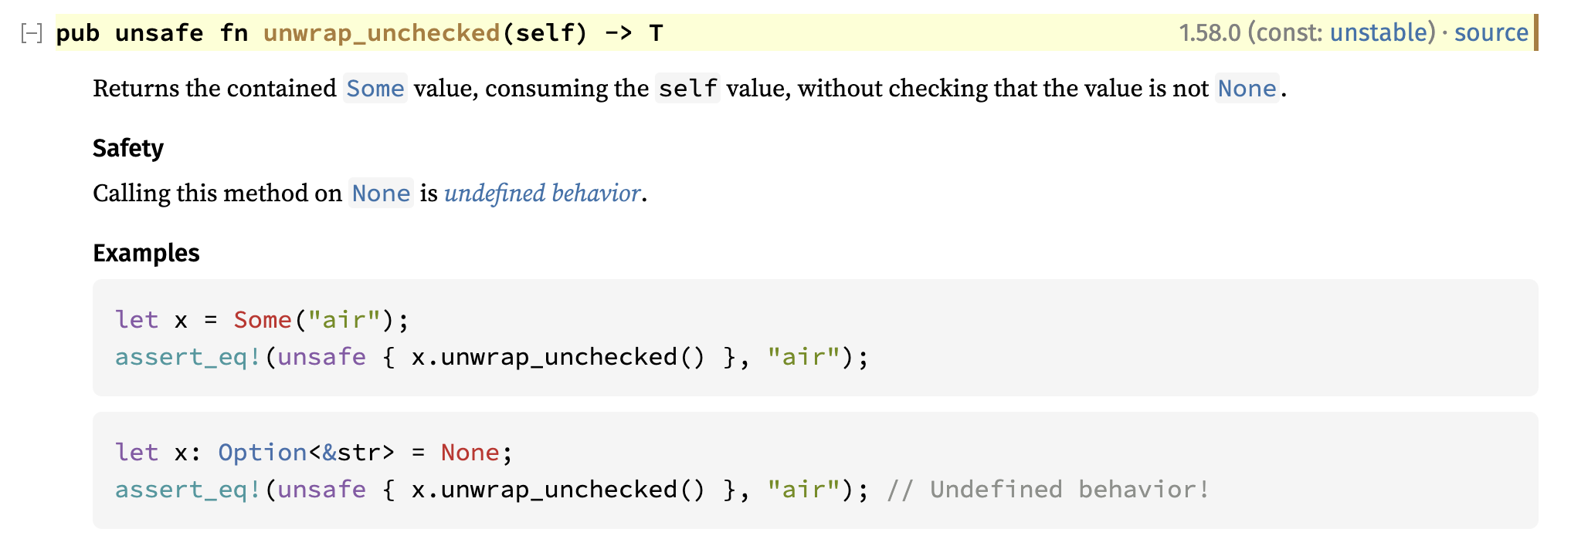
Example: Option::unwrap_unchecked
The subtext here is that behavior is defined if self is Some(_)
https://doc.rust-lang.org/std/option/enum.Option.html#method.unwrap_unchecked

Slide 9
What is unsafe code?
Unsafe code is really Conditionally Safe code — if the condition is satisfied, then it is safe
impl<T> Option<T> {
fn unwrap_unchecked(self) -> (res: T)
requires self.is_some()
ensures self == Some(res)
{
/* ... */
}
}
These conditions can be made explicit and formal using Verus preconditions

Slide 10
Unsafe Code

Slide 11

Unsafe Code
Notes:
Put this way, unsafe code doesn’t sound so bad. “Unsafe code” just means it has a requires clause, which is what you all have been practicing with all day. But —

Slide 12

Unsafe pointers

Slide 13
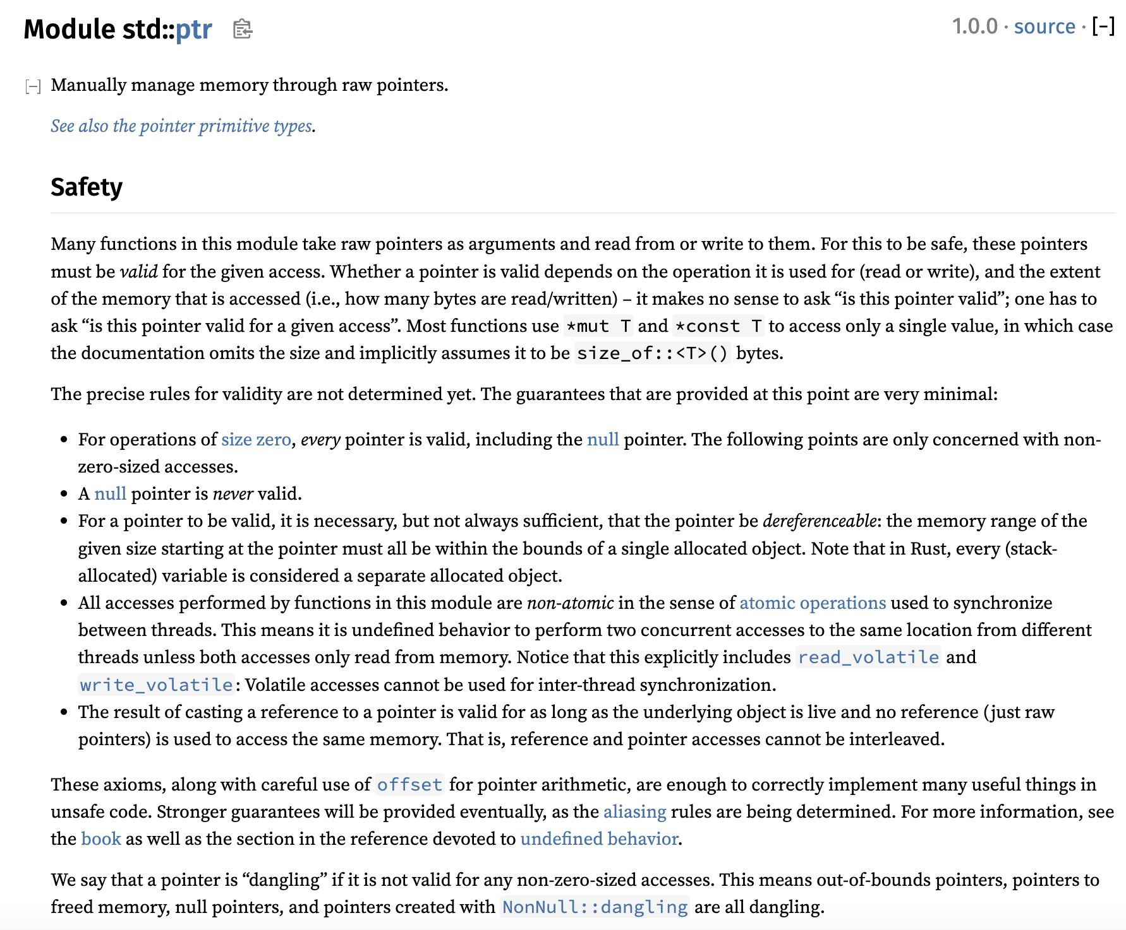
Let’s check the docs again

Slide 14
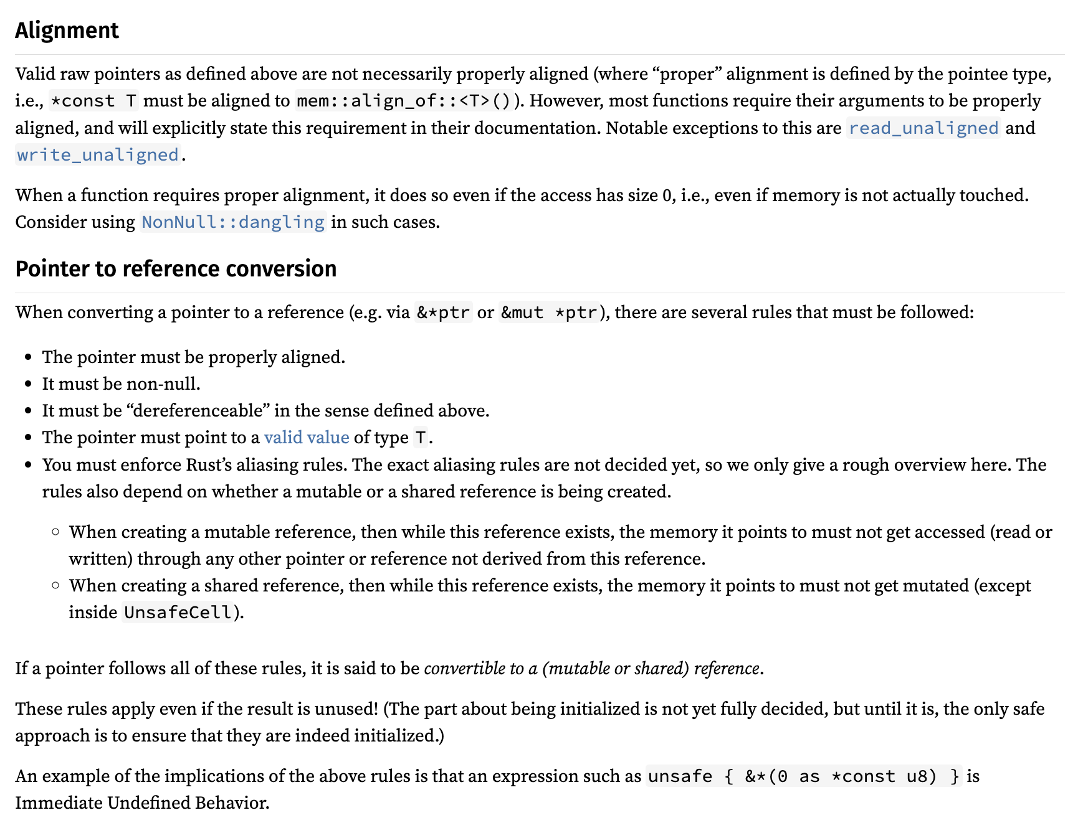
Let’s check the docs again

Slide 15
Let’s check the docs again
It keeps going, by the way

Slide 16
Pointers have a lot of conditions
Accessing a pointer requires:
Memory is valid, allocated, well-aligned
Reads must be initialized
Accesses are data-race-free
Playing nice with reference system (&T and &mut T)
Handling “pointer provenance”
Can these conditions even be expressed via Verus preconditions?

Slide 17

Isn’t this what ownership types are for?
Ordinarily, Rust’s type system, together with its clever standard library types (&T, &mut T, Box<T>, Rc<T>, Arc<T>, RefCell<T>, …), ensure that all the rules are followed
But the whole point of using “raw pointers” is that we can’t use those types…
Now we’re just going in circles!
Notes:
The point is that Rust does have the capability to cleanly reason about these concepts, it’s just slightly out of reach. We need to grasp a little farther.

Slide 18
Isn’t this what ownership types are for?
Ordinarily, Rust’s type system, together with its clever standard library types (&T, &mut T, Box<T>, Rc<T>, Arc<T>, RefCell<T>, …), ensure that all the rules are followed
But the whole point of using “raw pointers” is that we can’t use those types…
Solution: Decouple the ownership reasoning from the physical pointers; reason about ownership in “proof code”

Slide 19
Pointers have a lot of conditions
Accessing a pointer requires:
Memory is valid, allocated, well-aligned
Reads must be initialized
Accesses are data-race-free
Place nice with reference system (&T and &mut T)
Handling “pointer provenance”
For the demo & exercise, we’ll use Verus’s “Simple PPtr” library, which sands down the rougher edges at the cost of generality — but it still covers the key points

Slide 20
[PPtr demo]

Slide 21
Recap
In general, “unsafe code” is actually Conditionally Safe
i.e., it has a requires clause
However, for advanced cases like raw pointers, safety comes from a combination of this requires clause with complex ownership reasoning
We can handle this ownership reasoning in proof code, without tying it to the physical types

Slide 22
Interior mutability

Slide 23

What is interior mutability?
Rust’s references are usually described to new users as follows:
Type
&mut T | Unique | Mutable
&T | Shared | Immutable
Unfortunately it’s not entirely correct …
Sometimes described as “shared XOR mutable,” this is an important property that enables Rust’s memory safety & Verus’s efficient SMT encoding

Slide 24
What is interior mutability?
Interior mutability is a pattern wherein you can modify data behind a shared reference (&).
However, this is only possible through specialized “interior mutability” types (e.g., Cell, RefCell, Mutex, RwLock, UnsafeCell)
This is good, because unrestricted mutation-through-& would ruin all the theory behind Verus’s encoding
As it is, we can restrict the additional complexity only to when these specialized types are involved

Slide 25
Interior mutability types
Cell
RefCell
Mutex
RwLock

Slide 26
Interior mutability types
Cell
RefCell
Mutex
RwLock
For single-threaded use

Slide 27
Interior mutability types
Cell
RefCell
Mutex
RwLock
For single-threaded use
Thread-safe; for multi-threaded use
Spectrum of trade-offs in terms of overhead / flexibility

Slide 28
[RwLock demo]

Slide 29
Interior mutability types
Cell
RefCell
Mutex
RwLock
UnsafeCell
For single-threaded use
Thread-safe; for multi-threaded use
All of these can be approached using invariants
Aside: This usually warrants a different bag-of-tricks (PointsTo)

Slide 30
Let’s talk about this a bit more
Interior mutability is a pattern wherein you can modify data behind a shared reference (&).
However, this is only possible through specialized “interior mutability” types (e.g., Cell, RefCell, Mutex, RwLock, UnsafeCell)
This is good, because unrestricted mutation-through-& would ruin all the theory behind Verus’s encoding
As it is, we can restrict the additional complexity only to when these specialized types are involved
Notes:
For the rest of the section, I want to talk more about these last 2 points. Why does interior mutability not ruin the simplicity of the Verus’s encoding that is otherwise afforded by Rust’s strict aliasing rules?

Slide 31
Interior mutability encapsulates mutation
&mut T

Slide 32

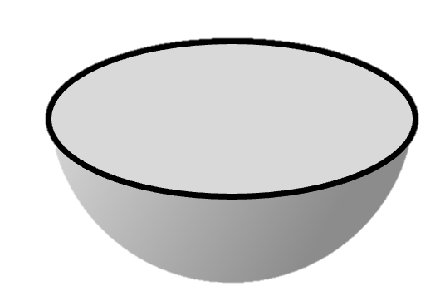
Interior mutability encapsulates mutation
Turbo
Encapsulator
&mut T

Slide 33
Interior mutability encapsulates mutation
&mut T

Slide 34
Interior mutability encapsulates mutation
Consider a library with a type FooObject that uses interior mutability:
Internally, FooObject mutates it private, interior state.
Externally, clients get to work with a &FooObject, which is both easier to use and reason about.
The mutability is not “infectious”!
Notes:
In this sense, interior mutability actually becomes a reasoning *aid*, not a complexifier.
Of course, this isn’t always possible – sometimes the client needs to reason about the evolving state of FooObject; but if the mutation is purely an implementation detail, this can be a huge aid for ergonomics and reasoning.

Slide 35
Interior mutability encapsulates mutation
Immutable objects are easier to reason about
&FooObject
Client code
&FooObject
&FooObject
&FooObject
Depends on
struct FooObject
Library code
Interior mutation:
Notes:
The reason this is possible is that interior mutability allows for the *encapsulation* of mutation, as in this diagram here. This depicts a library with a type called FooObject, and internally it does some mutation via interior mutability. Meanwhile, the client code operates on a shared reference to FooObject, so we can reason about the client code as if there were no mutation at all. This is sort of hinted at by the name “interior mutability”, i.e., the mutation inside the library code isn’t observed externally. In this sense, interior mutability actually becomes a reasoning *aid*, not a complexifier. [click for speech bubble]

Slide 36
Example: Memoizing a deterministic fn
Suppose we have some expensive but deterministic computation
pub fn expensive_function(args: &Args) -> Output {
/* ... */
}
struct Memoizer {
map: HashMap<Args, Output>
}
impl Memoizer {
pub fn get(&mut self, args: &Args) -> Output {
match self.map.get(args) {
Some(result) => result.clone(),
None => {
// Compute for the first time and store the result for next time
let result = expensive_function(args);
self.map.insert(args.clone(), result.clone());
result
}
}
}
}
We can memoize the results — lazily populate a lookup-table of results, as-needed

Slide 37
Example: Memoizing a deterministic fn
Now, what if we want to share the Memoizer across multiple subsystems? Maybe even across threads?
Arc<Memoizer> → &Memoizer
Whoops, now we can’t call get —
fn get(&mut self, args: &Args)

Slide 38
Example: Memoizing a deterministic fn
pub fn expensive_function(args: &Args) -> Output {
/* ... */
}
struct Memoizer {
map: HashMap<Args, Output>
}
impl Memoizer {
pub fn get(&mut self, args: &Args) -> Output {
match self.map.get(args) {
Some(result) => result.clone(),
None => {
// Compute for the first time and store the result for next time
let result = expensive_function(args);
self.map.insert(args.clone(), result.clone());
result
}
}
}
}

Slide 39
Example: Memoizing a deterministic fn
We really want to implement this instead:
fn get(&self, args: &Args)
And this is why we need interior mutability.

Slide 40
Example: Memoizing a deterministic fn
pub fn expensive_function(args: &Args) -> Output {
/* ... */
}
struct Memoizer {
ref_cell: RefCell<HashMap<Args, Output>>
}
impl Memoizer {
pub fn get(&self, args: &Args) -> Output {
let map_handle = self.ref_cell.borrow_mut();
match map_handle.get(args) {
Some(result) => result.clone(), None => {
// Compute for the first time and store the result for next time
let result = expensive_function(args);
map_handle.insert(args.clone(), result.clone());
result
}
}
}
}

Slide 41
Example: Memoizing a deterministic fn
pub fn expensive_function(args: &Args) -> Output {
/* ... */
}
struct Memoizer {
lock: RwLock<HashMap<Args, Output>>
}
impl Memoizer {
pub fn get(&self, args: &Args) -> Output {
let map_handle = self.lock.write().expect();
match map_handle.get(args) {
Some(result) => result.clone(), None => {
// Compute for the first time and store the result for next time
let result = expensive_function(args);
map_handle.insert(args.clone(), result.clone());
result
}
}
}
}
Which type you want to use depends on your specific requirements, but verification will likely use the same basic idea in any case.

Slide 42
Adding a specification
pub spec fn func(args: &Args) -> Output { ... }
pub fn expensive_function(args: &Args) -> (output: Output)
ensures output == func(args)
{ ... }
impl Memoizer {
pub fn get(&self, args: &Args) -> Output
ensures output == func(args)
{ ... }
}
Function must be deterministic
Memoizer is deterministic and computes the same function

Slide 43
Adding a specification
pub spec fn func(args: &Args) -> Output { ... }
pub fn expensive_function(args: &Args) -> (output: Output)
ensures output == func(args)
{ ... }
impl Memoizer {
pub fn get(&self, args: &Args) -> Output
ensures output == func(args)
{ ... }
}
Function must be deterministic
Memoizer is deterministic and computes the same function
Observe again how the mutation is encapsulated

Slide 44
One last question
Verus relies on this property — “shared XOR mutable,” that no state is mutable and shared at the same time — for its efficient SMT encoding.
Interior mutability breaks this property, yet Verus can still support it. How is this possible?

Slide 45
Recap
Interior mutability carves an exception to the usual “sharing XOR mutability” dichotomy of Rust, which Verus relies on
Many use-cases can be handled with lock invariants / monitor invariants
Encapsulation of mutability prevents interior mutability from infecting a codebase and ruining Verus’s simple encoding

Slide 46
Notes:
Rope font is from: https://www.fontspace.com/category/rope

Slide 47
We already covered locks actually …
But one big global lock does not concurrency make!
Notes:
A global lock is _multi-threaded_ but it isn’t truly concurrent.

Slide 48
Realistic systems use fine-grained locks

Slide 49
Realistic systems use fine-grained locks
We can talk about the invariant on a single lock

Slide 50
Realistic systems use fine-grained locks
We can talk about the invariant on a single lock
But how do we relate all the locks together?

Slide 51
What is concurrency, generally?
True Concurrency requires us to have multiple components that can be owned and operated on independently and simultaneously

Slide 52
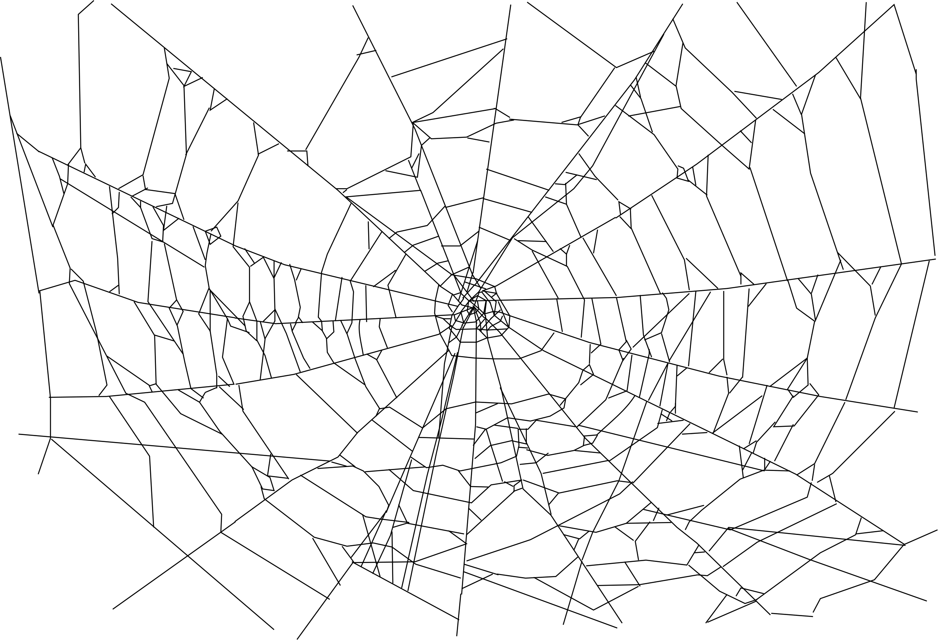
But how do we reason globally?
We need an invariant that “reaches across space”

Slide 53
Example 2: Producer/consumer queue
Thread 1
Thread 2
Thread 3
Thread 4
These components, owned by different threads, need to coordinate somehow
Producer
Producer
Producer
Producer
Queue Buffer
Consumer
Consumer
Consumer
Consumer
Thread 5
Thread 6
Thread 7
Thread 8

Slide 54
Example 3: “Agreement”
fn update_pair(mut token0: Token,
mut token1: Token, new_value: u64
) -> (pair: (Token, Token))
requires token0.id == token1.id
ensures
pair.0.value == new_value,
pair.1.value == new_value,
pair.0.id == token0.id,
pair.1.id == token1.id,
{
token0.value = new_value;
token1.value = new_value;
(token0, token1)
}
fn validate_pair(token0: &Token, token1: &Token)
requires token0.id == token1.id
ensures token0.value == token1.value
{
/* ? */
}
struct Token {
id: Id,
value: u64
}
fn new_pair(value: u64) -> (pair: (Token, Token))
ensures
pair.0.id == pair.1.id,
pair.0.value == value,
pair.1.value == value,
{
let id = fresh_id();
(Token { id: id, value: value },
Token { id: id, value: value })
}

Slide 55
Example 3: “Agreement”
fn update_pair(mut token0: Token,
mut token1: Token, new_value: u64
) -> (pair: (Token, Token))
requires token0.id == token1.id
ensures
pair.0.value == new_value,
pair.1.value == new_value,
pair.0.id == token0.id,
pair.1.id == token1.id,
{
token0.value = new_value;
token1.value = new_value;
(token0, token1)
}
fn validate_pair(token0: &Token, token1: &Token)
requires token0.id == token1.id
ensures token0.value == token1.value
{
/* ? */
}
struct Token {
id: Id,
value: u64
}
fn new_pair(value: u64) -> (pair: (Token, Token))
ensures
pair.0.id == pair.1.id,
pair.0.value == value,
pair.1.value == value,
{
let id = fresh_id();
(Token { id: id, value: value },
Token { id: id, value: value })
}

Slide 56
Example 3: “Agreement”
fn update_pair(mut token0: Token,
mut token1: Token, new_value: u64
) -> (pair: (Token, Token))
requires token0.id == token1.id
ensures
pair.0.value == new_value,
pair.1.value == new_value,
pair.0.id == token0.id,
pair.1.id == token1.id,
{
token0.value = new_value;
token1.value = new_value;
(token0, token1)
}
fn validate_pair(token0: &Token, token1: &Token)
requires token0.id == token1.id
ensures token0.value == token1.value
{
/* ? */
}
struct Token {
id: Id,
value: u64
}
fn new_pair(value: u64) -> (pair: (Token, Token))
ensures
pair.0.id == pair.1.id,
pair.0.value == value,
pair.1.value == value,
{
let id = fresh_id();
(Token { id: id, value: value },
Token { id: id, value: value })
}

Slide 57
Example 3: “Agreement”
fn update_pair(mut token0: Token,
mut token1: Token, new_value: u64
) -> (pair: (Token, Token))
requires token0.id == token1.id
ensures
pair.0.value == new_value,
pair.1.value == new_value,
pair.0.id == token0.id,
pair.1.id == token1.id,
{
token0.value = new_value;
token1.value = new_value;
(token0, token1)
}
fn validate_pair(token0: &Token, token1: &Token)
requires token0.id == token1.id
ensures token0.value == token1.value
{
/* ? */
}
struct Token {
id: Id,
value: u64
}
fn new_pair(value: u64) -> (pair: (Token, Token))
ensures
pair.0.id == pair.1.id,
pair.0.value == value,
pair.1.value == value,
{
let id = fresh_id();
(Token { id: id, value: value },
Token { id: id, value: value })
}

Slide 58
Example 3: “Agreement”
fn update_pair(mut token0: Token,
mut token1: Token, new_value: u64
) -> (pair: (Token, Token))
requires token0.id == token1.id
ensures
pair.0.value == new_value,
pair.1.value == new_value,
pair.0.id == token0.id,
pair.1.id == token1.id,
{
token0.value = new_value;
token1.value = new_value;
(token0, token1)
}
fn validate_pair(token0: &Token, token1: &Token)
requires token0.id == token1.id
ensures token0.value == token1.value
{
/* ? */
}
struct Token {
id: Id,
value: u64
}
fn new_pair(value: u64) -> (pair: (Token, Token))
ensures
pair.0.id == pair.1.id,
pair.0.value == value,
pair.1.value == value,
{
let id = fresh_id();
(Token { id: id, value: value },
Token { id: id, value: value })
}

Slide 59
Example 3: “Agreement”
fn update_pair(mut token0: Token,
mut token1: Token, new_value: u64
) -> (pair: (Token, Token))
requires token0.id == token1.id
ensures
pair.0.value == new_value,
pair.1.value == new_value,
pair.0.id == token0.id,
pair.1.id == token1.id,
{
token0.value = new_value;
token1.value = new_value;
(token0, token1)
}
fn validate_pair(token0: &Token, token1: &Token)
requires token0.id == token1.id
ensures token0.value == token1.value
{
/* ? */
}
struct Token {
id: Id,
value: u64
}
fn new_pair(value: u64) -> (pair: (Token, Token))
ensures
pair.0.id == pair.1.id,
pair.0.value == value,
pair.1.value == value,
{
let id = fresh_id();
(Token { id: id, value: value },
Token { id: id, value: value })
}
Who maintains this invariant?

Slide 60
Verus’s System: VerusSync
Provides a means for “space-reaching invariants”
Acknowledges that real systems need invariants a little more complicated than two-party agreement.

Slide 61
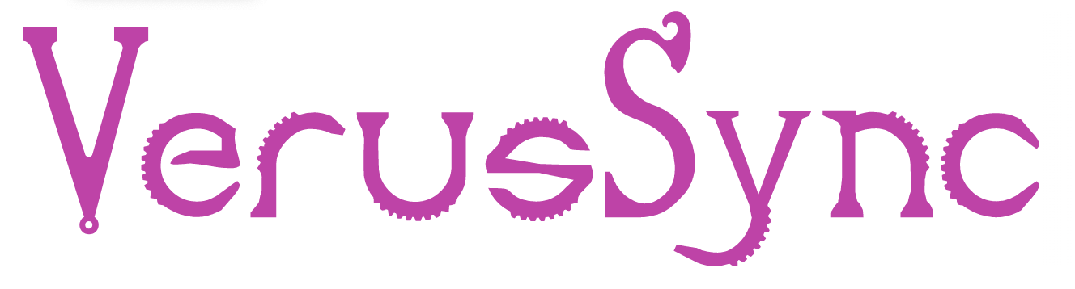
Verus’s System: VerusSync
VerusSync provides:
Ghost objects (like PointsTo)
Developer defines:
State
VerusSync
Operations
Invariants
With a space-reaching invariants

Slide 62
Verus’s System: VerusSync

Slide 63
Verus’s System: VerusSync
You can connect the ghost state to other state you care about via more lock invariants

Slide 64

Notes:
The space-reaching invariant reaches through the ”ghost dimension”

Slide 65
[Demo: Concurrent FIFO]

Slide 66

Recap
Memory permissions
Space-reaching invariants
Lock invariants

